Slide 1
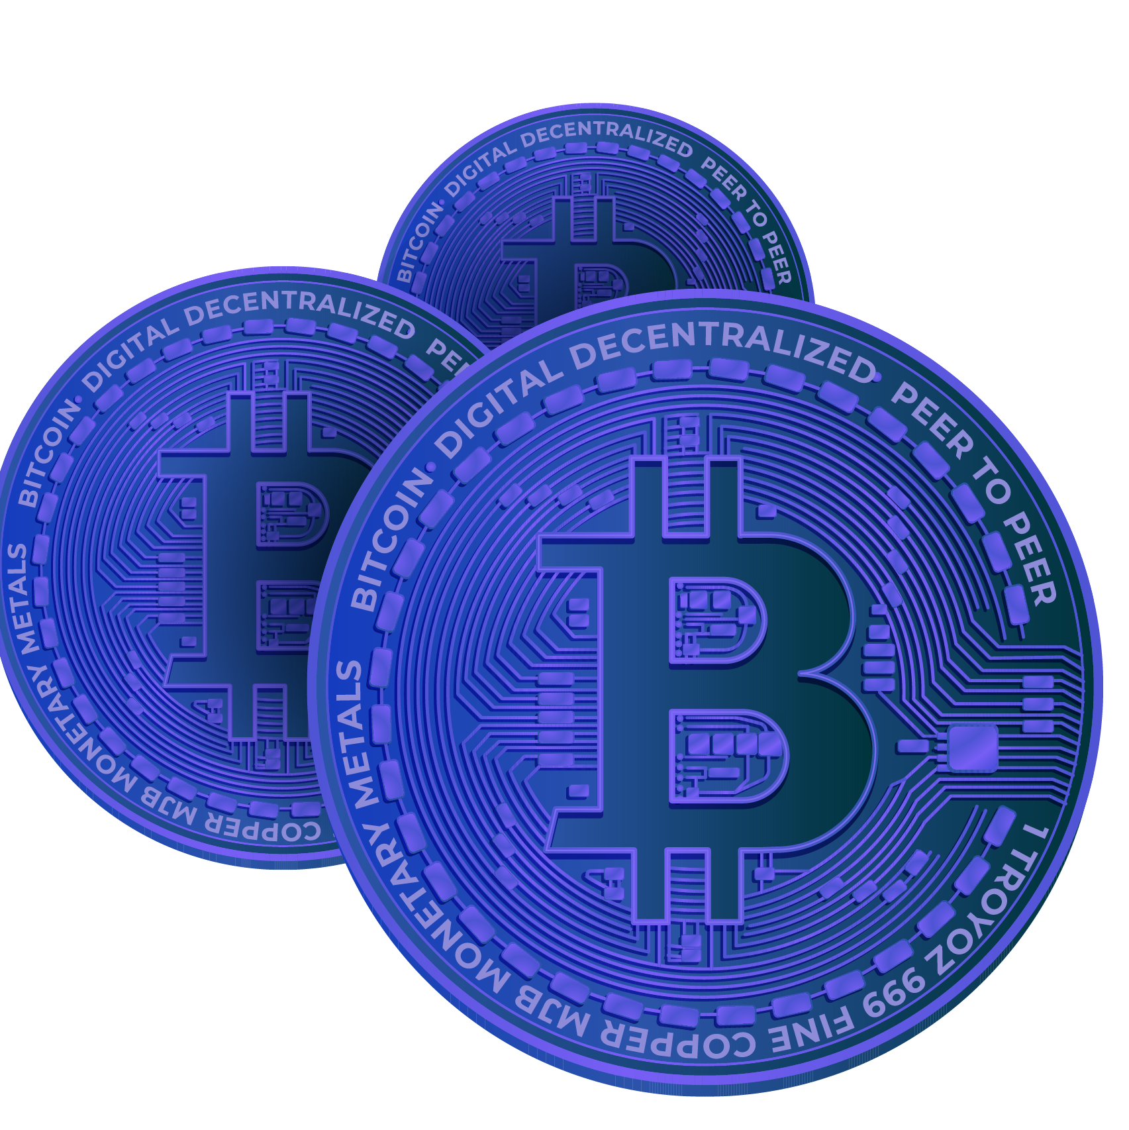
Voting DAO & Funding Pool web3 DECENTRALIZED BLOCKCHAIN SYSTEM
By Eskandar Atrakchi
Notes:
1. Table of contents
2. Introduction
3. Our company
4. Our team
5. Problem
6. Them vs. us
7. Solution
8. SWOT analysis
9. Product overview
10. Our plans
11. Product demo
12. Traction
13. Case study
14. Reviews
15. Awards
16. Market size
17. Target
18. Competitors
19. Business model
20. Timing
21. Predicted growth
22. Investment

Slide 2
Contents of this presentation
Here’s what we’ll talk about:
1. Current Systems
2. Problem Statement
3. The Solution
4. Key Features
5. Technology Stack
6. Risks & Mitigation
7. Call to Action

Slide 3
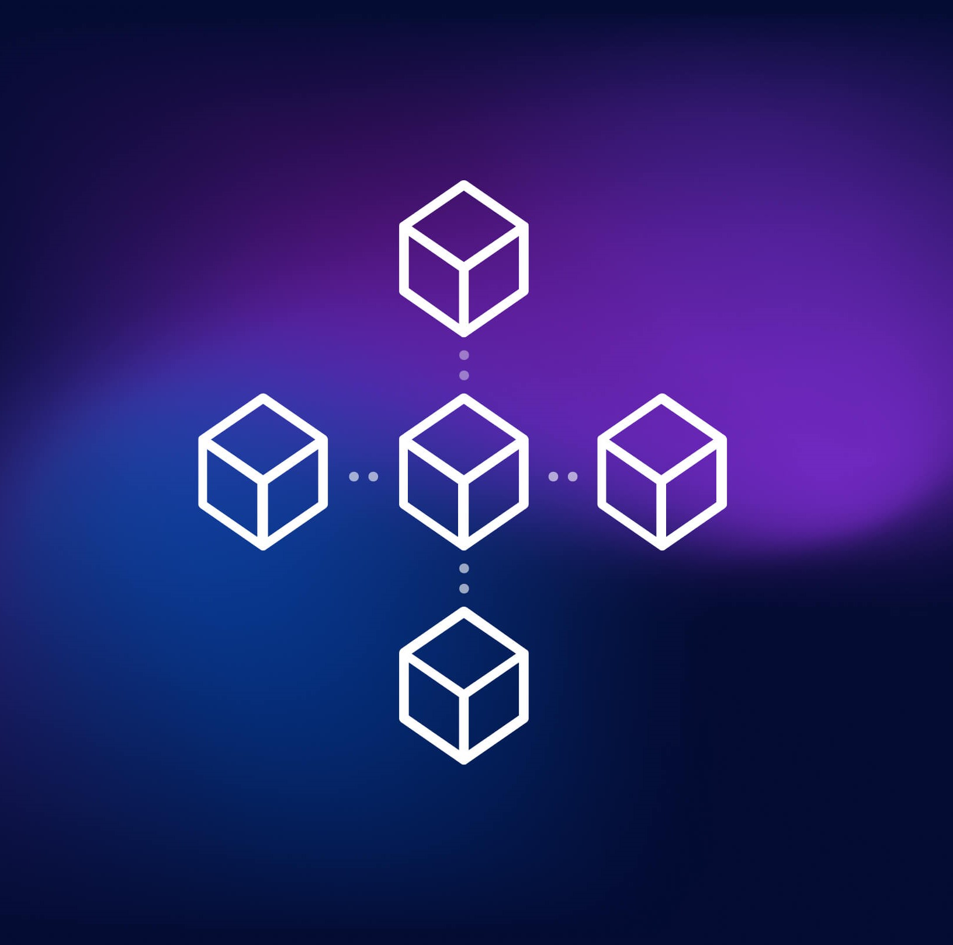
Current systems
Traditional Banks
Companies
Institutions
WEB2

Slide 4
Some of the problems of current systems
01
02
03
04
Centralization
Trust needed
All companies depend on centralized servers to handle their operations
There is no way to verify, just trust me bro
Not transperant
Controlled
All the transactions are private and seen only by the insiders
They can control your action or shutdown your account.

Slide 5
“Therefore, if we want to express an opinion or transact value we will be controlled.”
— I

Slide 6
Solutions of the problems of current systems
01
02
03
04
De-Centralization
Trust-less
The consensus mechism determines if transactions are valide or not
Verify, don’t trust
Transperant
Can’t be Controlled
All transaction available to the public
Only the owner can control their funds, no body else should

Slide 7
Node
Node 3
World with web2
Node 2
Node 1
Decentralized nodes to secure blockchain network and achieving distribution and security.
To see the nodes operates live visit: https://mempool.space/graphs/lightning/nodes-channels-map
World with web3

Slide 8
WEB2 vs. WEB3
WEB2
WEB3
Web2 centralized, controlled, not verified, lack of transparency, and integrity
Decentralized, owner based, trustless, tranparent

Slide 9
Key features of my project
Trust-less & transparent voting
Integration with MetaMask & Snapshot
Token-weighted and quadratic voting
Gasless off-chain voting with on-chain execution

Slide 10
Technology Stack
Solidity, Hardhat, ethers.js
React frontend, IPFS storage
OpenZeppelin libraries, zk-SNARKs exploration

Slide 11
Risks & Mitigation
Smart contracts bugs
Code audit
Low adoption
Improvement in UI/UX optimization incentives & rewards
Sybil attack
Identity improvement mechanism

Slide 12
x23137517@student.ncirl.ie
Phone No.: 0858277706
TikTok: @itiscoded
Thank you!
Do you have any questions?

